Slide 1



Probabilistic Embeddings for Cross-Modal Retrieval
Chun, Sanghyuk, et al. "Probabilistic embeddings for cross-modal retrieval." Proceedings of the IEEE/CVF Conference on Computer Vision and Pattern Recognition. 2021.
Alireza Mazochi

Slide 2
Overview
Introduction
Method
Results
Conclusion

Slide 3
Introduction

Slide 4
The Title of the Article
“Probabilistic Embeddings
for
Cross-Modal Retrieval”

Slide 5
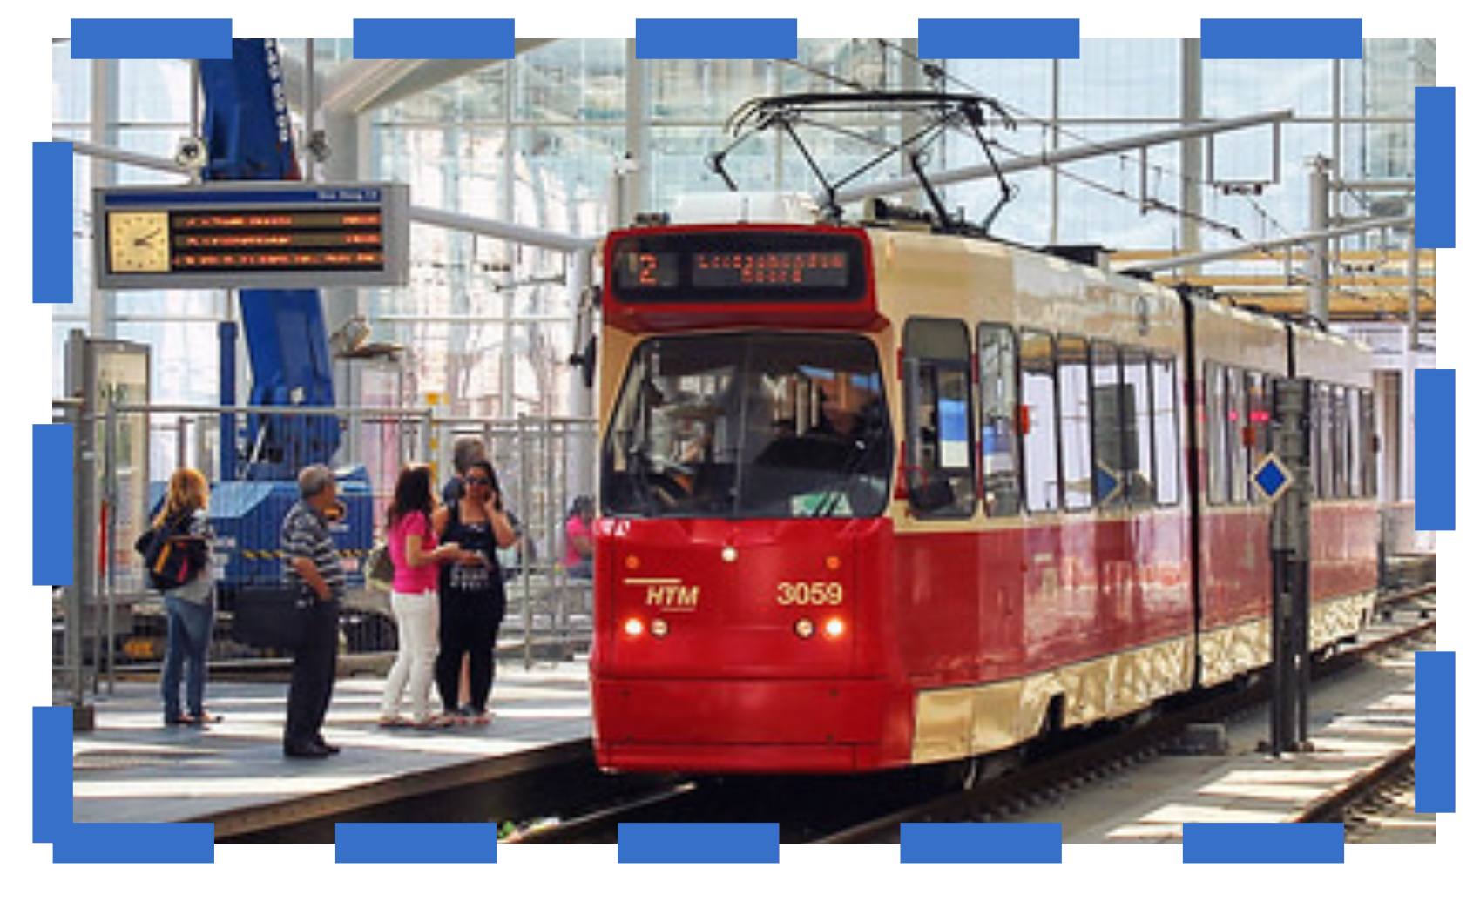


Cross-Modal Retreival
$$Image$$
Modality
People waiting to board a train in a train station
$$Text$$

Slide 6
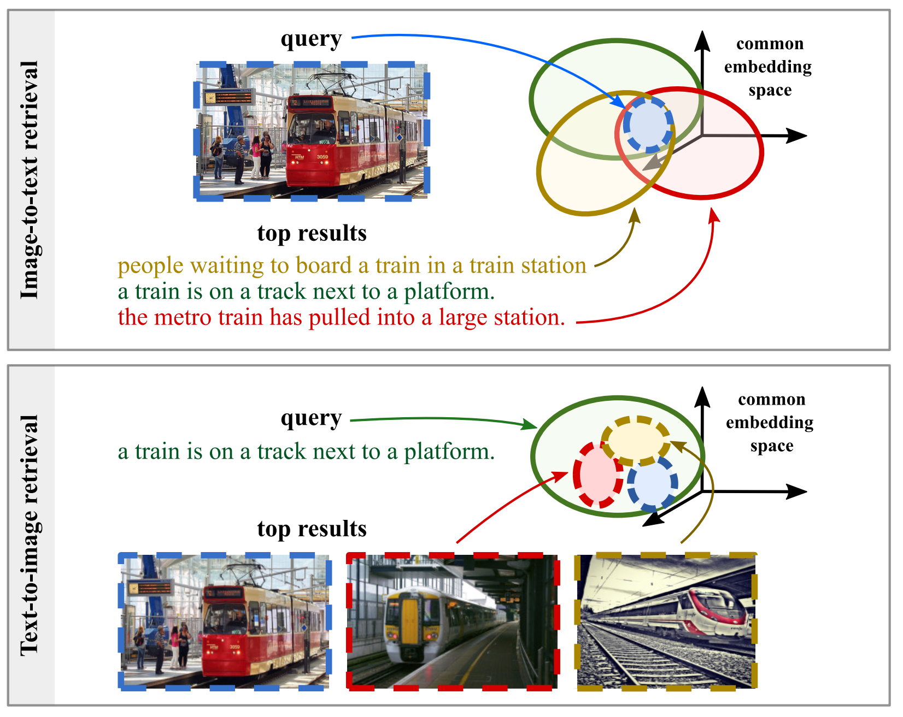
Probabilistic Embedding

Slide 7
Method

Slide 8
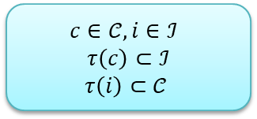
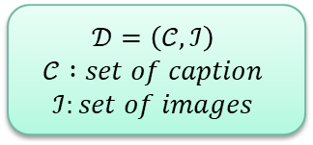
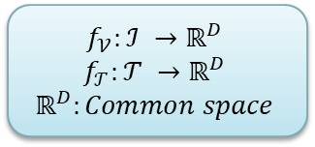
Problem Formulation
$$𝒟=\left(𝒞, ℐ\right)$$
$$𝒞 :set of caption$$
$$ℐ:set of images$$
$$c∈𝒞, i∈ℐ$$
$$τ\left(c\right)⊂ℐ$$
$$τ\left(i\right)⊂𝒞$$
$$f_{𝒱}:ℐ →ℝ^{D}$$
$$f_{𝒯}:𝒯 →ℝ^{D}$$
$$ℝ^{D}:Common space$$

Slide 9
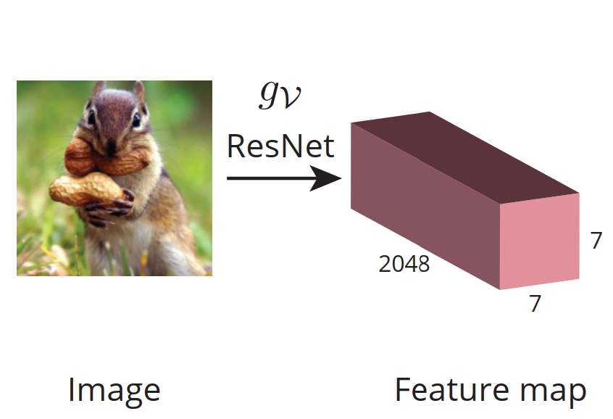
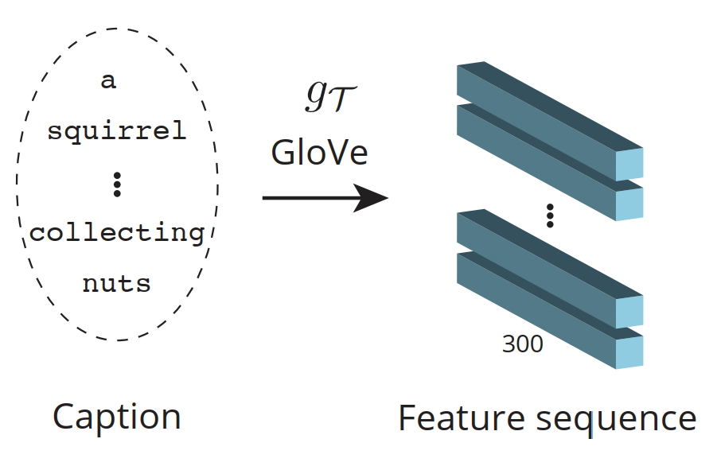
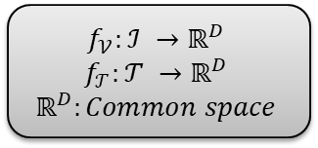
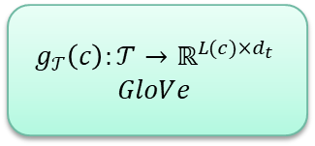
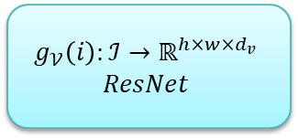
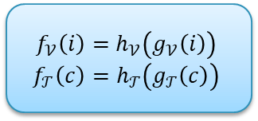
Encoders
$$g_{𝒱}\left(i\right):ℐ→ℝ^{h×w×d_{v}}$$
$$ResNet$$
$$f_{𝒱}:ℐ →ℝ^{D}$$
$$f_{𝒯}:𝒯 →ℝ^{D}$$
$$ℝ^{D}:Common space$$
$$f_{𝒱}\left(i\right)=h_{𝒱}\left(g_{𝒱}\left(i\right)\right)$$
$$f_{𝒯}\left(c\right)=h_{𝒯}\left(g_{𝒯}\left(c\right)\right)$$
$$g_{𝒯}\left(c\right):𝒯→ℝ^{L(c)×d_{t}}$$
$$GloVe$$

Slide 10
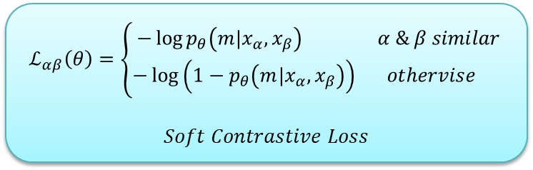
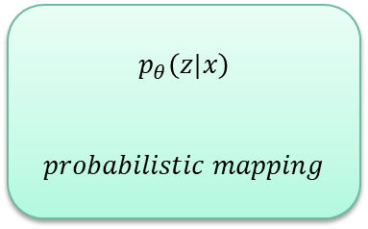
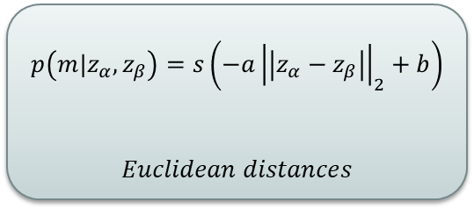
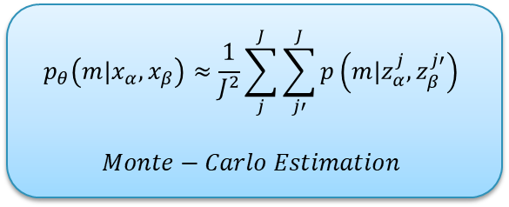
Probabilistic Embeddings for a Single Modality
$$p_{θ}\left(z|x\right)$$
$$probabilistic mapping$$
$$ℒ_{αβ}\left(θ\right)=\left\{\begin{aligned}−\log{p_{θ}\left(m|x_{α},x_{β}\right) α \& β similar} \\ −\log\left(1−p_{θ}\left(m|x_{α},x_{β}\right)\right) othervise \end{aligned}\right.$$
$$Soft Contrastive Loss$$
$$p_{θ}\left(m|x_{α}, x_{β}\right)≈\frac{1}{J^{2}}\sum_{j}^{J}{\sum_{j′}^{J}{p\left(m|z_{α}^{j},z_{β}^{j′}\right)}}$$
$$Monte−Carlo Estimation$$
$$p\left(m|z_{α}, z_{β}\right)=s\left(−a{\left|\left|z_{α}−z_{β}\right|\right|}_{2}+b\right)$$
$$Euclidean distances$$

Slide 11
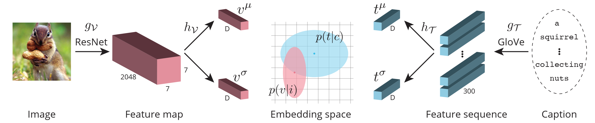
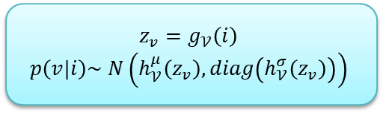
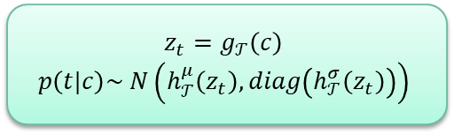
Model Overview
$$z_{v}=g_{𝒱}\left(i\right)$$
$$p\left(v|i\right)\sim N\left(h_{𝒱}^{μ}\left(z_{v}\right), diag\left(h_{𝒱}^{σ}\left(z_{v}\right)\right)\right)$$
$$z_{t}=g_{𝒯}\left(c\right)$$
$$p\left(t|c\right)\sim N\left(h_{𝒯}^{μ}\left(z_{t}\right), diag\left(h_{𝒯}^{σ}\left(z_{t}\right)\right)\right)$$

Slide 12
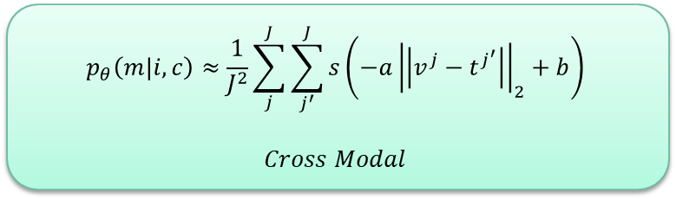
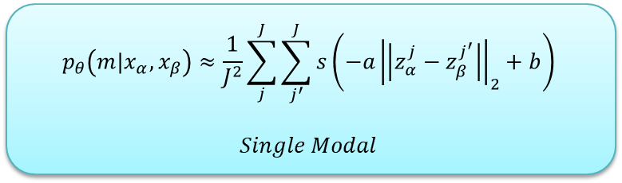
Soft cross-modal contrastive loss
$$p_{θ}\left(m|x_{α}, x_{β}\right)≈\frac{1}{J^{2}}\sum_{j}^{J}{\sum_{j^{′}}^{J}{s\left(−a{\left|\left|z_{α}^{j}−z_{β}^{j^{′}}\right|\right|}_{2}+b\right)}}$$
$$Single Modal$$
$$p_{θ}\left(m|i, c\right)≈\frac{1}{J^{2}}\sum_{j}^{J}{\sum_{j^{′}}^{J}{s\left(−a{\left|\left|v^{j}−t^{j^{′}}\right|\right|}_{2}+b\right)}}$$
$$Cross Modal$$

Slide 13
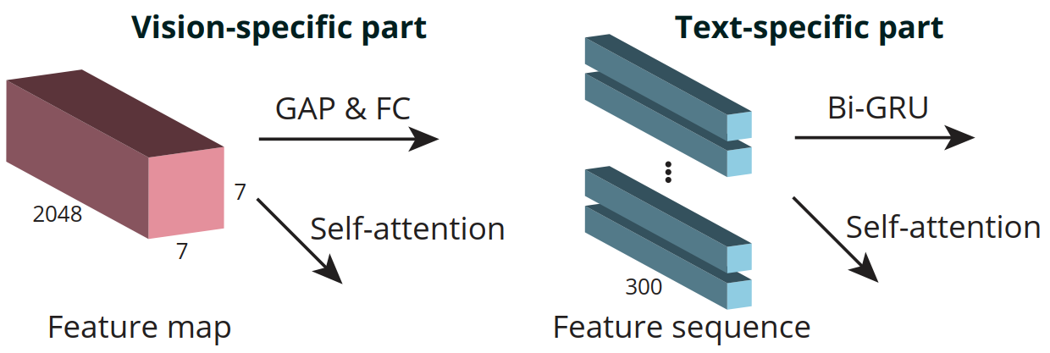
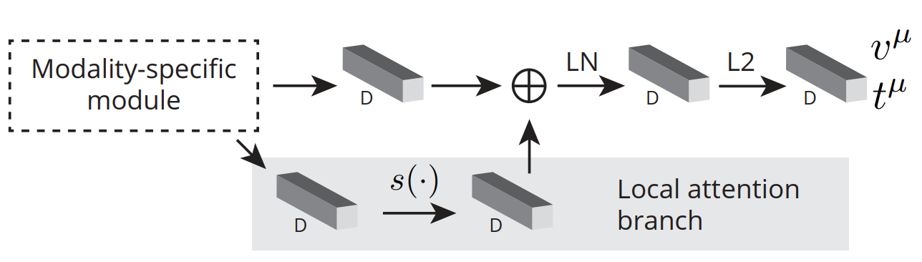
Local Attention Branch

Slide 14
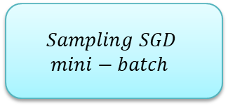
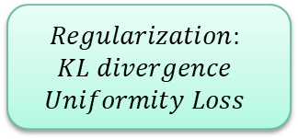
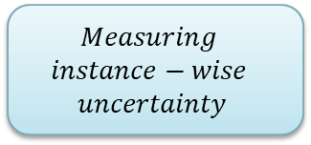
Other Ideas…
$$Regularization:$$
$$KL divergence$$
$$Uniformity Loss$$
$$Sampling SGD$$
$$mini−batch$$
$$Measuring$$
$$instance−wise$$
$$uncertainty$$

Slide 15
Experiments

Slide 16
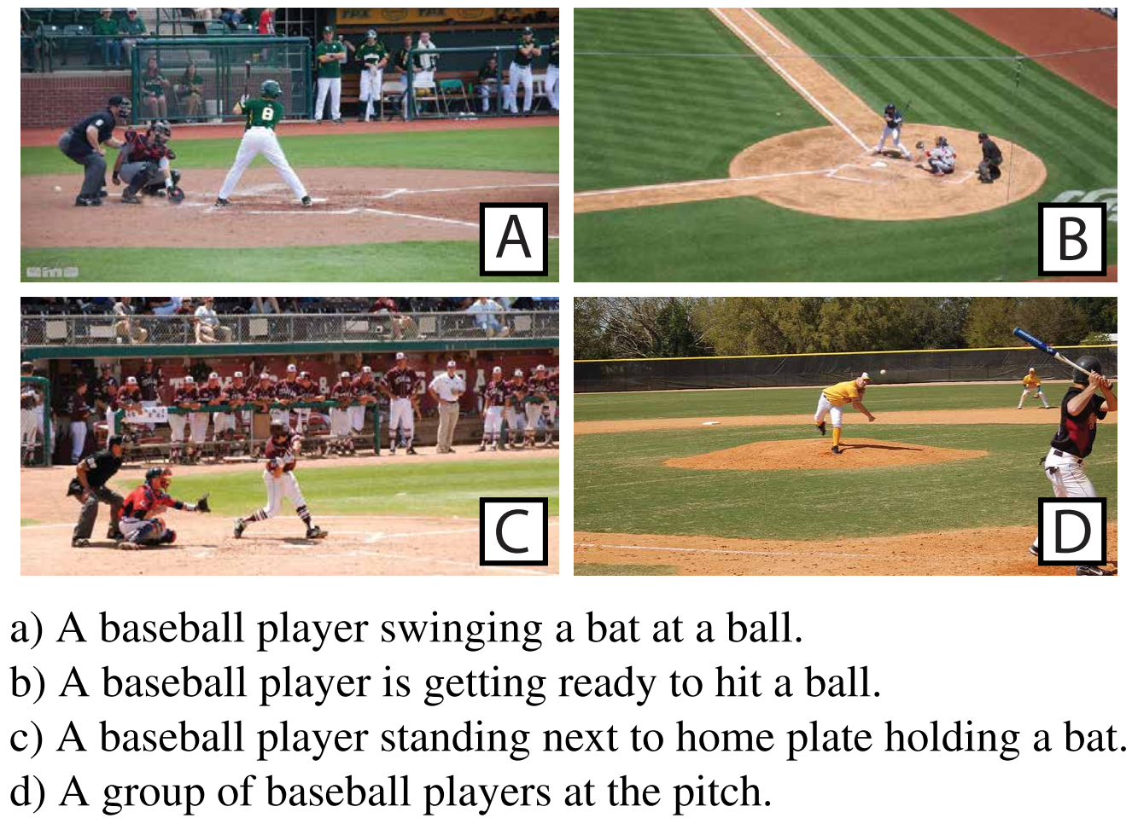
Datasets
COCO Caption
Five captions for each image
CUB
Bird images
200 classes
General images
150 train classes / 50 test classes
12K images
Lack of pair labels
123K training data
Repurpose
5K/1K testing data

Slide 17
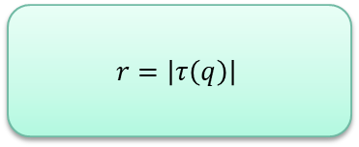
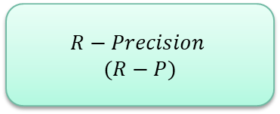
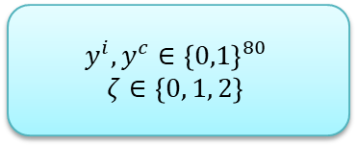
Evaluation Metric
$$R−Precision$$
$$(R−P)$$
Plausible Match (PM)
$$r=\left|τ\left(q\right)\right|$$
$$y^{i}, y^{c}∈{\left\{0,1\right\}}^{80}$$
$$ζ∈\left\{0, 1, 2\right\}$$

Slide 18
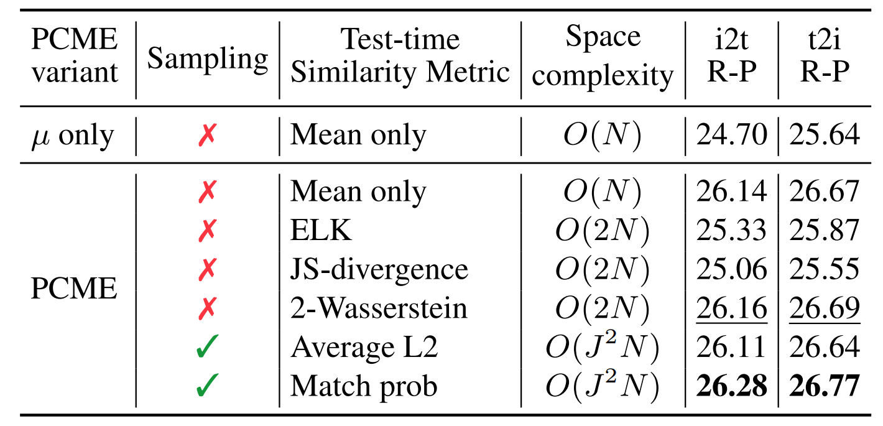
Pairwise Distances for Distributions

Slide 19
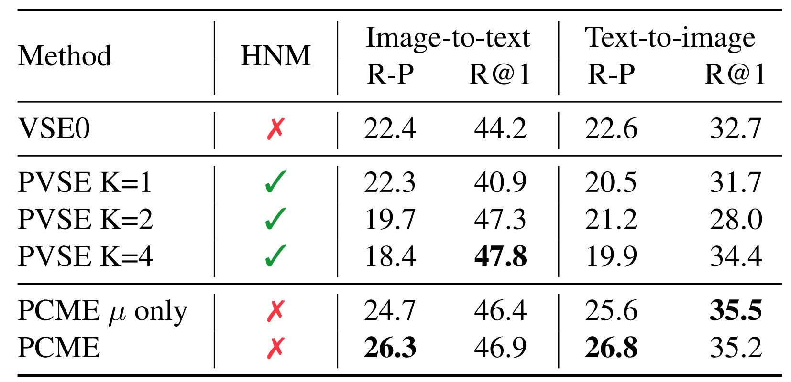
Comparison on CUB

Slide 20
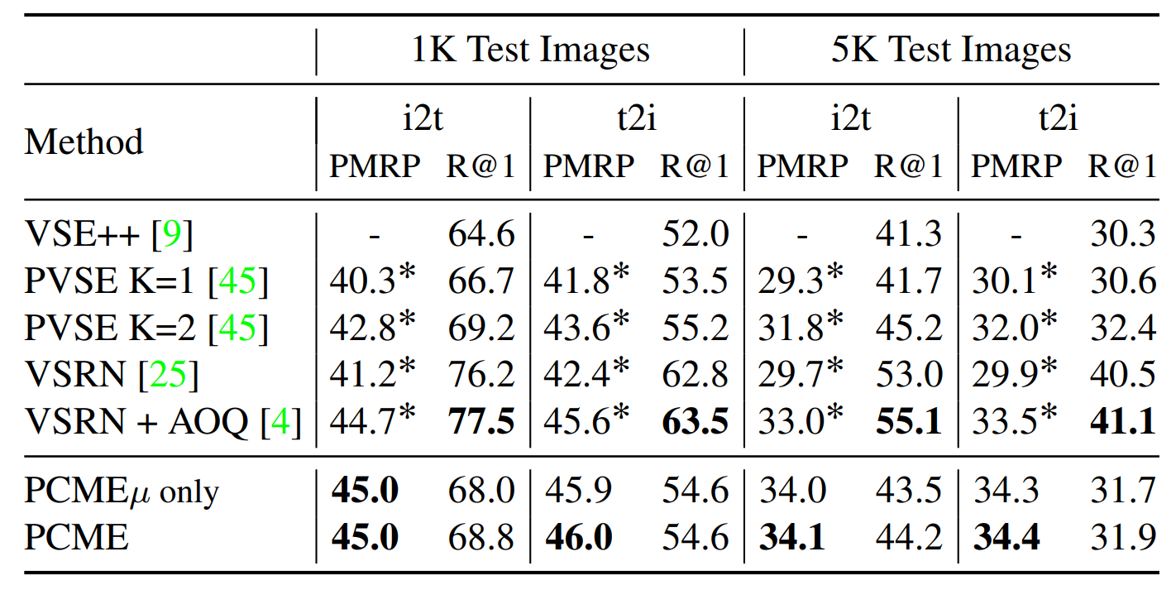
Comparison on COCO

Slide 21
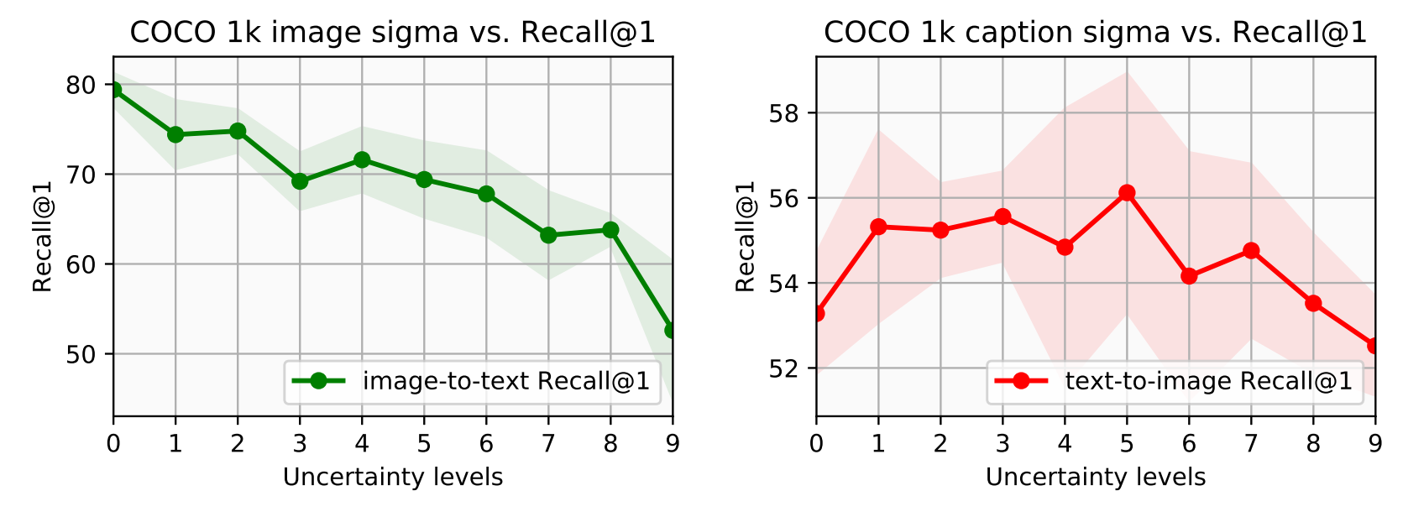
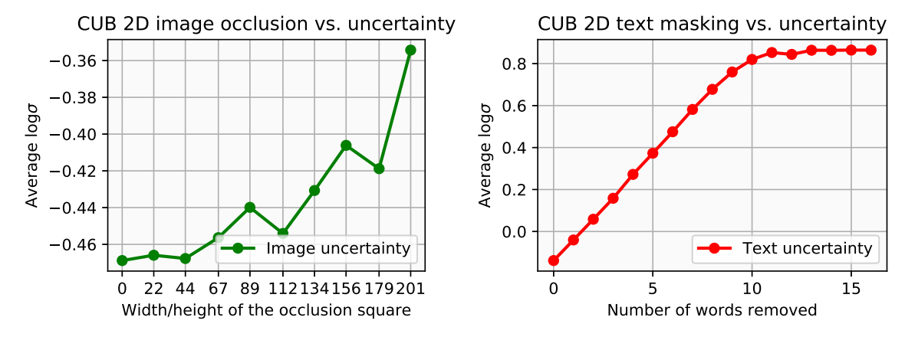
Uncertainty

Slide 22
Conclusion

Slide 23
Pros and Cons
Pros
Cons
Time and space complexity
Comprehensive results
Code availability
Novelty
Enabling algebraic relation
Unavailable perfect dataset
Uncertainty estimation

Slide 24
Future works
Other distributions
Other cross-modal
Using new encoders

Slide 25
References
[1] Chun, Sanghyuk, et al. "Probabilistic embeddings for cross-modal retrieval." Proceedings of the IEEE/CVF Conference on Computer Vision and Pattern Recognition. 2021.

Slide 26
Thanks For Attention!

